Slide 1
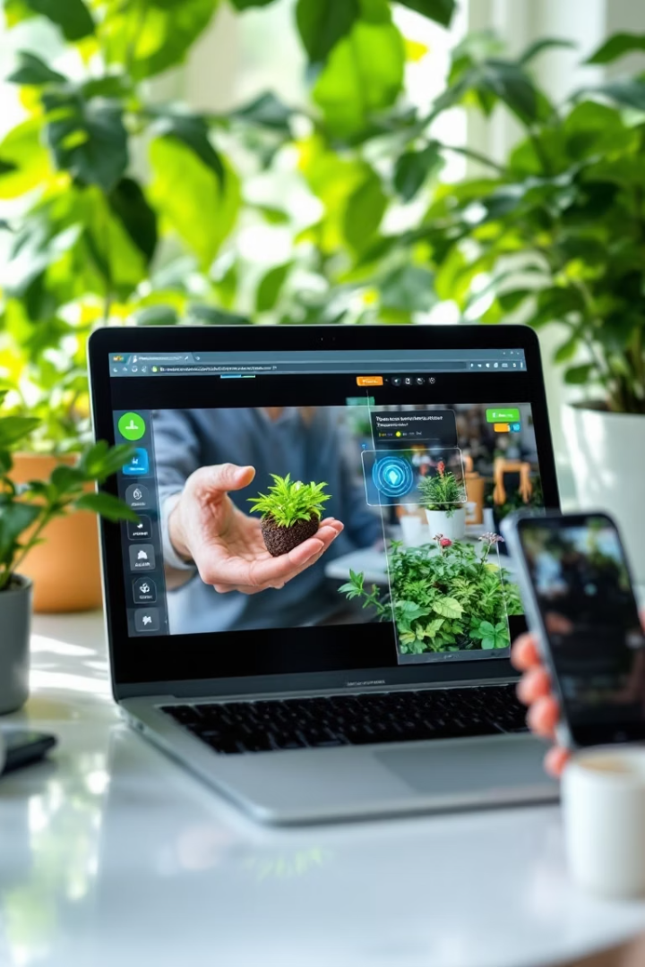
Real-time Plant Disease Detection Using YOLOv8
This project uses AI-driven YOLOv8 to detect plant diseases from live video streams.
The live stream shows annotated frames identifying disease spots on plants in real time.

Slide 2
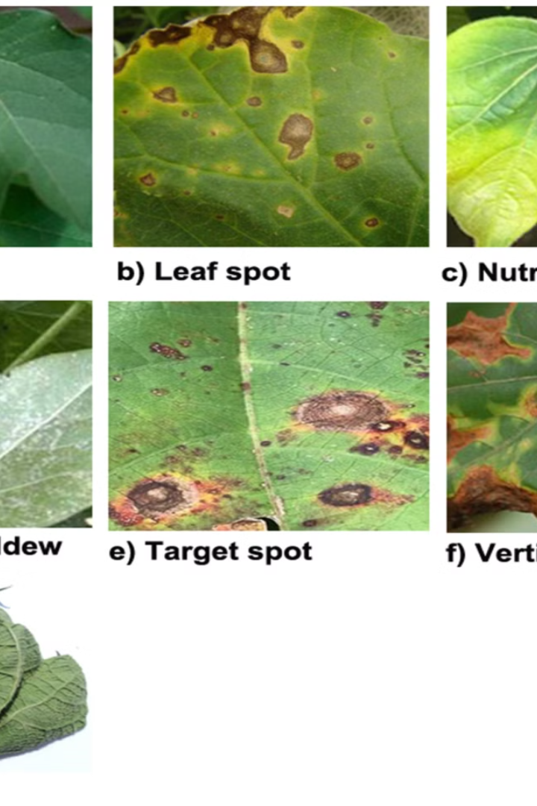
Plant Disease Detection Using YOLOv8 and OpenCV
Real-time plant disease detection using live video stream for precision agriculture.
Goal is early identification to reduce crop losses and improve yield.
This project bridges AI advancements with practical farming needs.

Slide 3
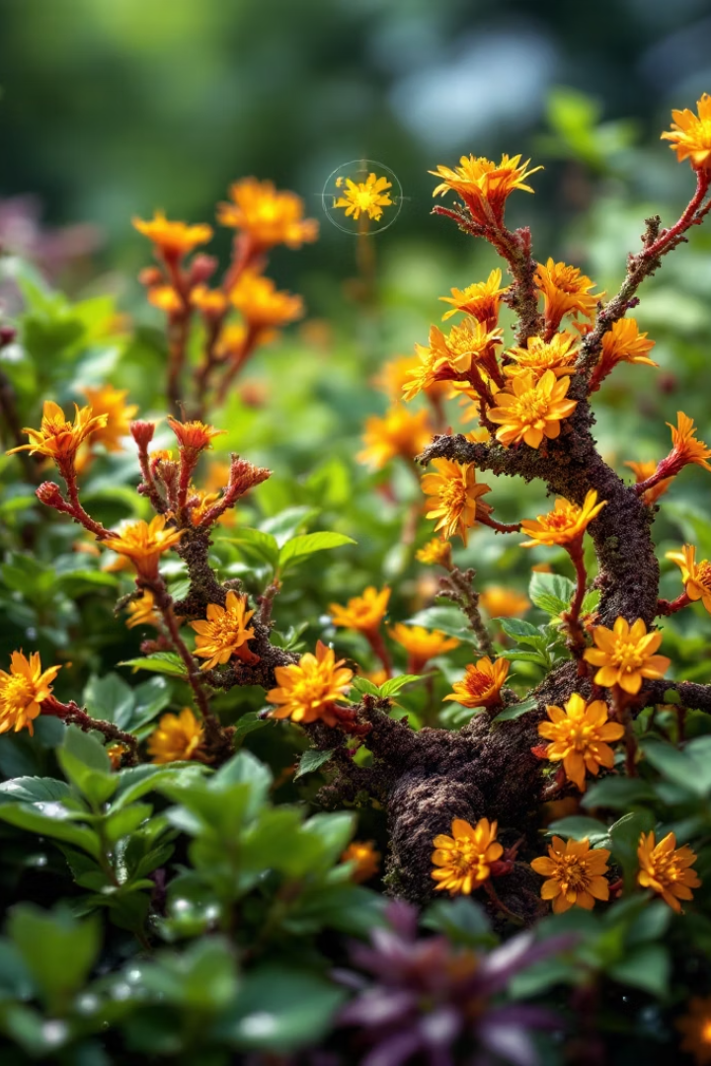
Area of the Project
Plant Pathology
Detecting diseases in crops using AI for healthy agriculture.
Computer Vision
Processing live video feeds with OpenCV for real-time analysis.
Machine Learning
Training YOLOv8 model on Roboflow dataset to identify diseases.
Mobile Integration
Using phone camera via DroidCam to provide live stream input.

Slide 4
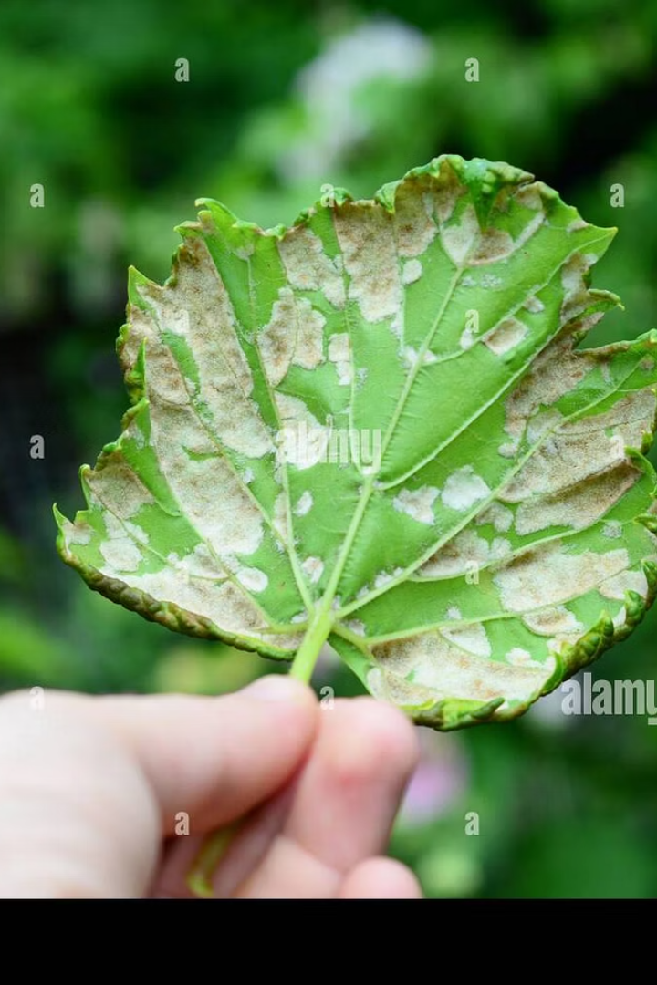
Problem Statement
Challenges
Crop Loss
Manual disease detection is time-consuming and inaccurate.
Delayed diagnosis leads to significant agricultural yield losses.
Need
Automated real-time disease detection using AI in live field conditions.

Slide 5
Literature Survey
Traditional Methods
Recent Advances
Visual inspection and lab testing are slow and subjective.
Deep learning models like YOLO widely used for object detection.
Often require expert knowledge and are costly.
Studies show high accuracy in controlled environments but fewer in field uses.

Slide 6
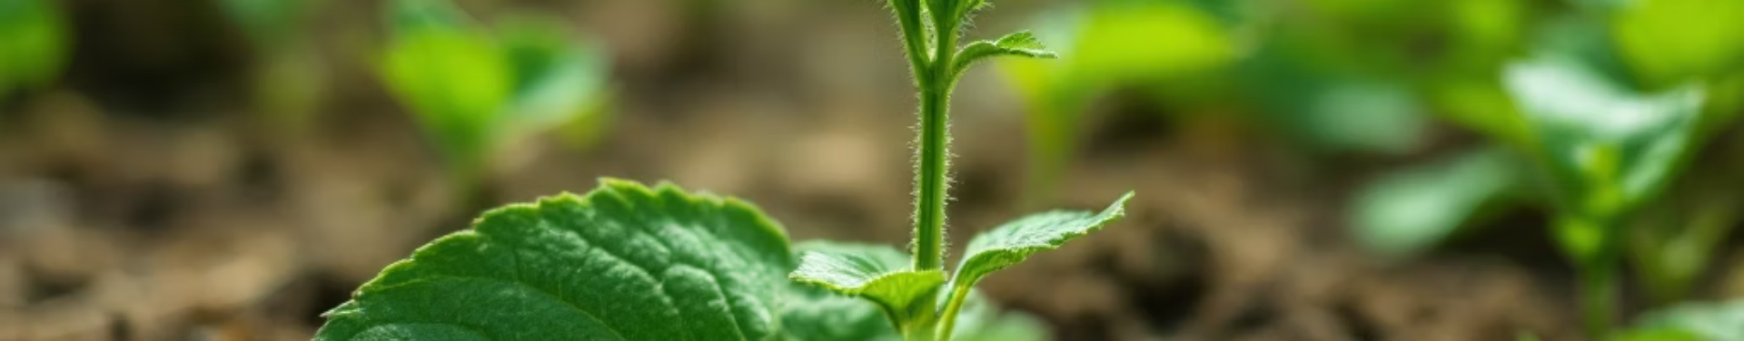
Objectives
Minimize Crop Loss
Real-time Detection
Enable early intervention through instant disease alerts.
Integrate Live Streaming
Show annotated frames with disease identification on live stream.
Train YOLOv8 Model
Use Roboflow dataset to detect multiple plant diseases accurately.
Connect phone camera via DroidCam to capture live video input.

Slide 7

Abstract
This project develops a system for live plant disease detection.
It employs YOLOv8 trained using Roboflow datasets and OpenCV integration.
Live camera footage from a phone is analyzed and annotated in real-time.
This facilitates faster diagnosis and timely agricultural decision-making.

Slide 8
Introduction
Motivation
Technology
Plant diseases cause major global food security risks.
YOLOv8 enables fast and accurate object detection in images.
Early detection can prevent severe crop loss and improve yield.
OpenCV facilitates image processing and video stream handling.

Slide 9
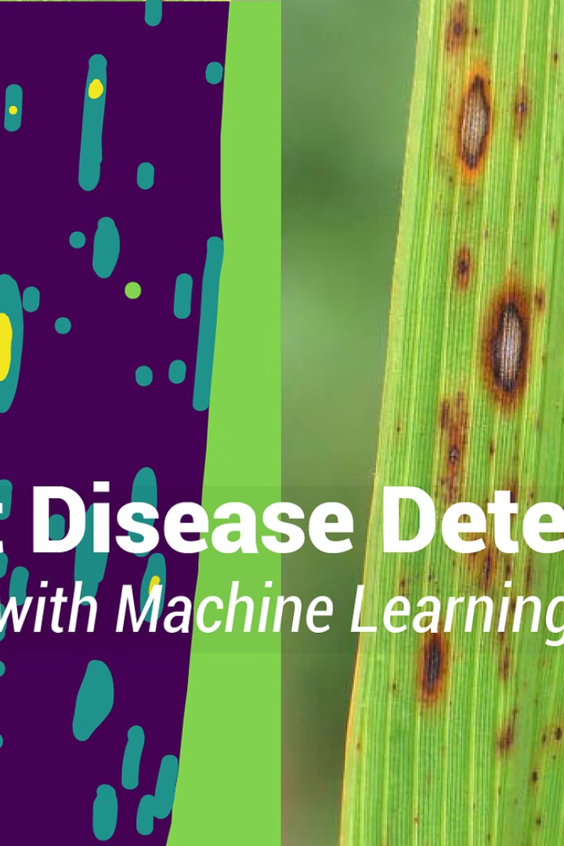
Existing System
Static Image Analysis
Manual Inspection
Labor-intensive and prone to human error.
Limited to photos; lacks real-time capability.
Limited Integration
No mobile live stream integration for field usage.

Slide 10
Proposed System
YOLOv8 Model
Live Stream Input
OpenCV Processing
User Interaction
Trained on diverse Roboflow dataset for multiple diseases.
Uses phone camera linked via DroidCam for continuous video.
Immediate visual feedback to assist quick decision-making.
Real-time annotation of frames showing disease detection.

Slide 11
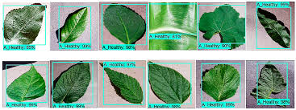
Expected Output
Real-time Display
Annotated live video frames detect diseases instantly.
Accurate Detection
High confidence in disease classification from trained model.
Mobile Device Compatible
Works seamlessly with phone cameras for field use.
Assist Farmers
Helps early disease spotting to reduce crop damage effectively.

Slide 12
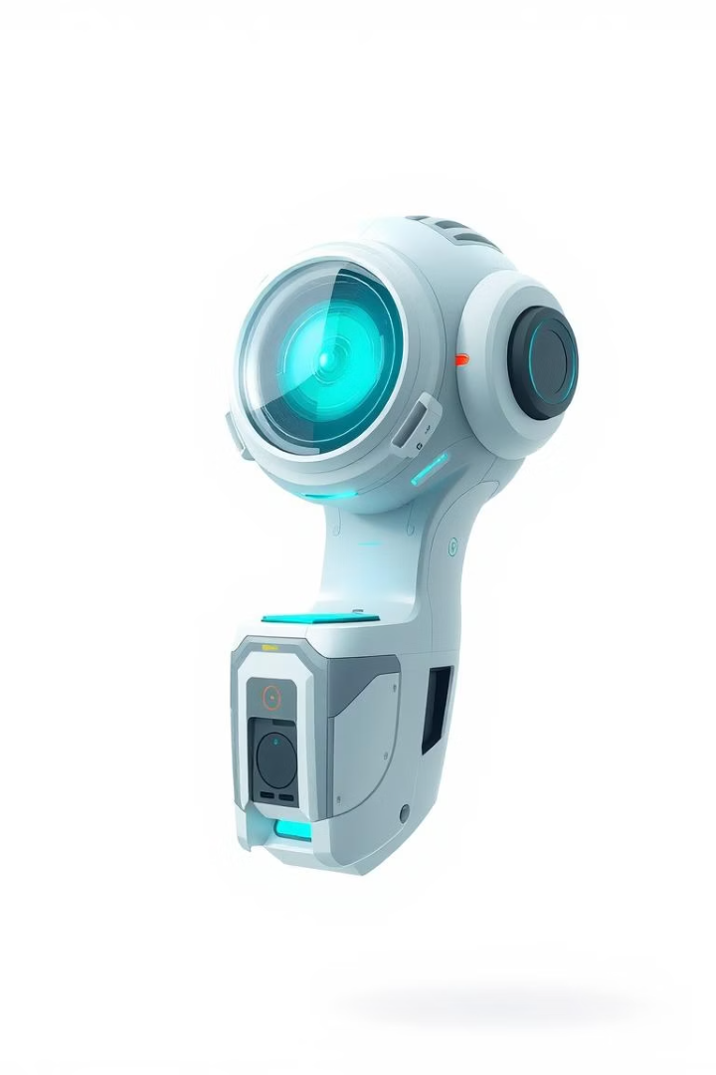
Workplan and Time Schedule
Here's a breakdown of the project timeline:
Months 1–2
Months 3–4
Research and requirements gathering to define project scope.
Collect data and train AI models for disease detection.
Months 5–6
Month 7
Develop hardware and software components of the system.
Conduct thorough testing and validate system performance.
Month 8
Prepare final report and deploy the functional prototype.

Slide 13
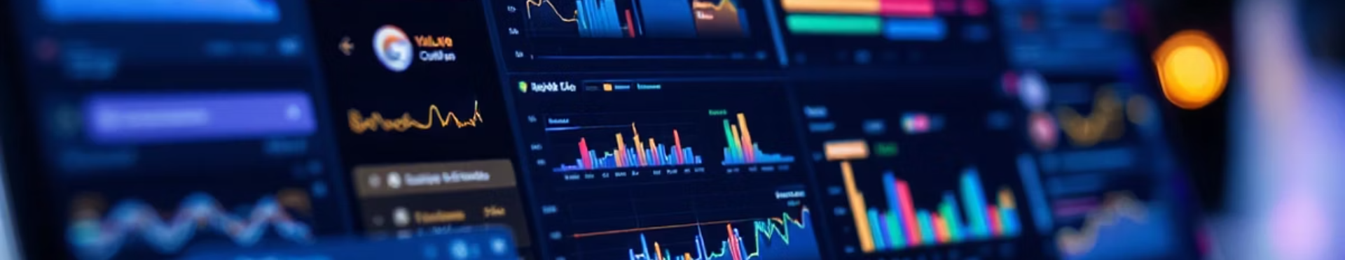
Hardware & Software Setup
Hardware
Software
Output
Laptop and smartphone connected via DroidCam for live camera feed.
YOLOv8 model trained on the Roboflow dataset using Google Colab.
Annotated live stream frames showing detected plant diseases.

Slide 14
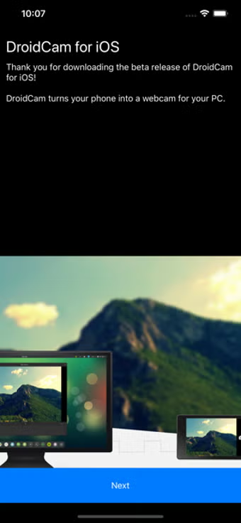
Hardware & Software Setup
Cost-Effective Image Capture Using DroidCam
As part of the system design, DroidCam was used to convert a smartphone into a high-resolution webcam for capturing real-time plant images. This approach provided a cost-effective and portable solution for image acquisition in field conditions. The captured images were then fed into the AI model for disease detection.
Using DroidCam eliminated the need for expensive camera modules and allowed easy deployment on farms with minimal hardware requirements.

Slide 15
Application in Plant Health Monitoring
Real-time Detection
Practical Benefits
The system analyzes live video from a phone camera for early disease signs.
Enables fast response to crop diseases
Reduces manual inspection time
Supports sustainable farming

Slide 16
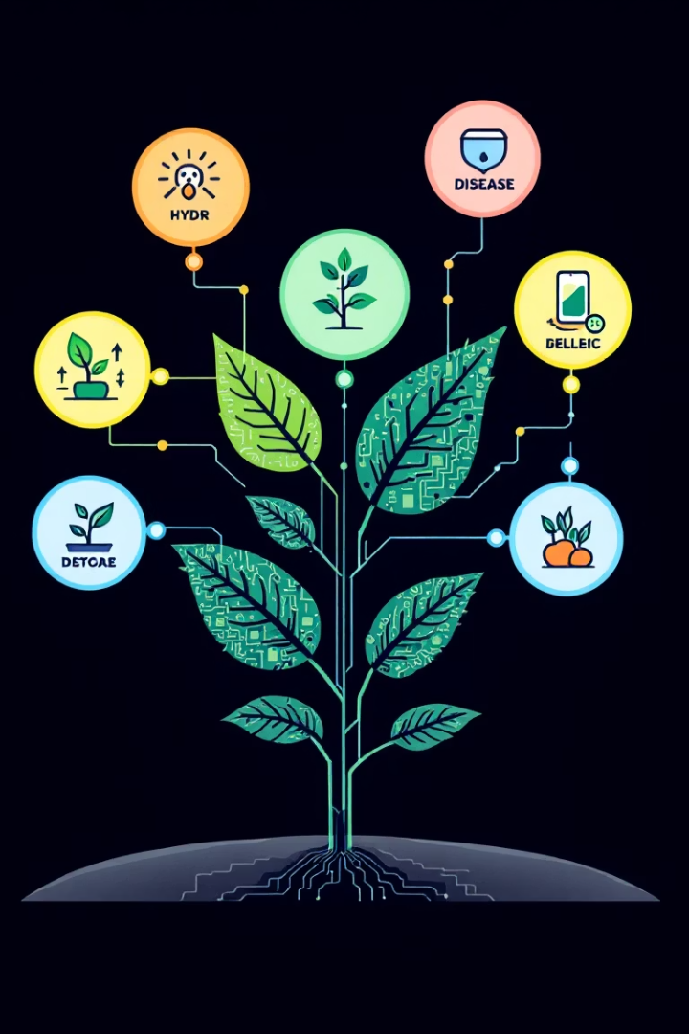
References & Tools
Dataset
Roboflow: Diverse annotated plant disease images.
Model
YOLOv8: State-of-the-art object detection framework.
Development
Google Colab for GPU-accelerated training and experimentation.
Camera
DroidCam connects smartphone camera to laptop live stream.

Slide 17
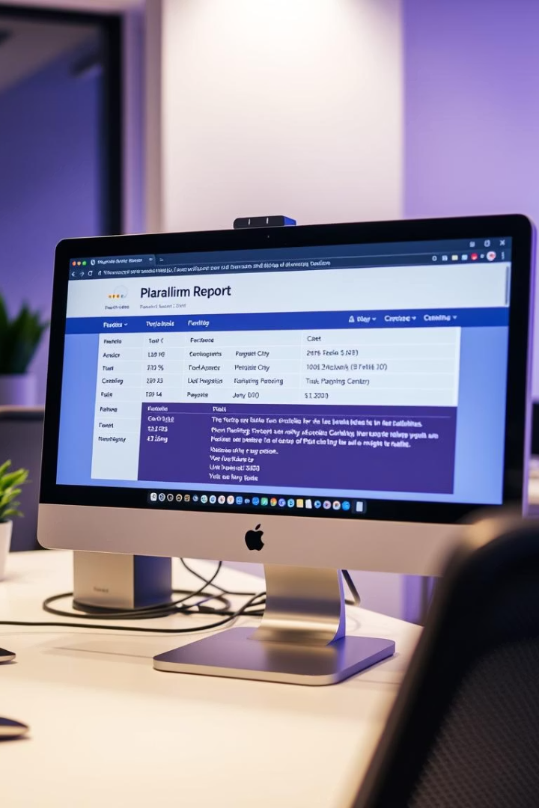
Plagiarism Report Summary
The plagiarism report ensures originality and academic integrity.
It highlights matched sources and calculates similarity percentages.
Maintaining originality is critical for credible research and reporting.

Slide 18
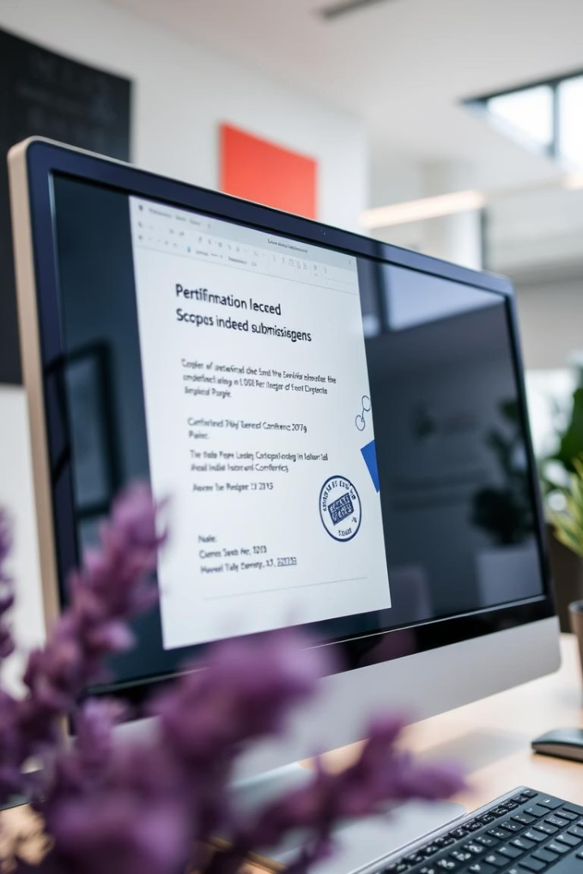
Scopus Indexed Conference & Patent Submission Proof
The project has been officially submitted to a Scopus indexed conference.
Patent filing acknowledges the innovative nature of the disease monitoring system.

Slide 19
Thank You

